Slide 1

Bitcoin Price Predictor
Data Science Batch # 469
LE WAGON PRESENTATION
November, 2020

Slide 2
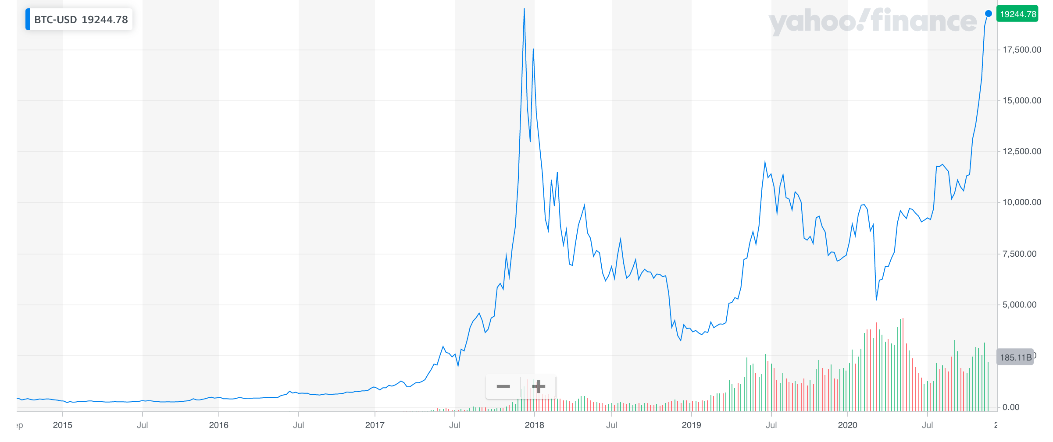
Bitcoin is a cryptocurrency invented by Satoshi Nakamoto, it started in 2009 when its implementation was released as open-source software
2014/09
2020/11
19.224$
400$
+ 4611%
Help investors and individuals make better informed decisions about when to invest in bitcoin

Slide 3

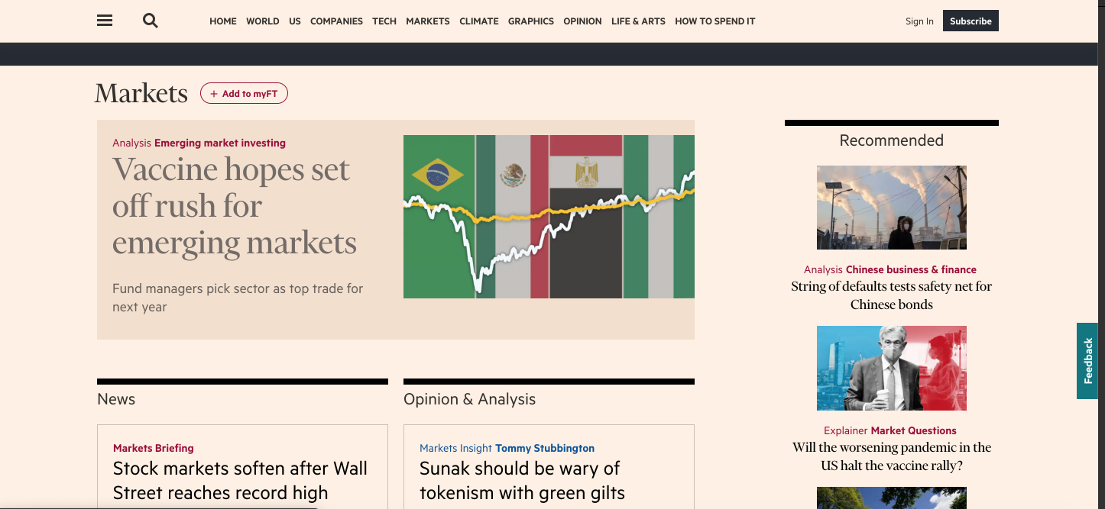
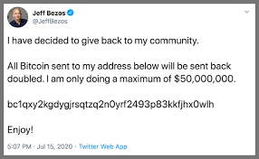
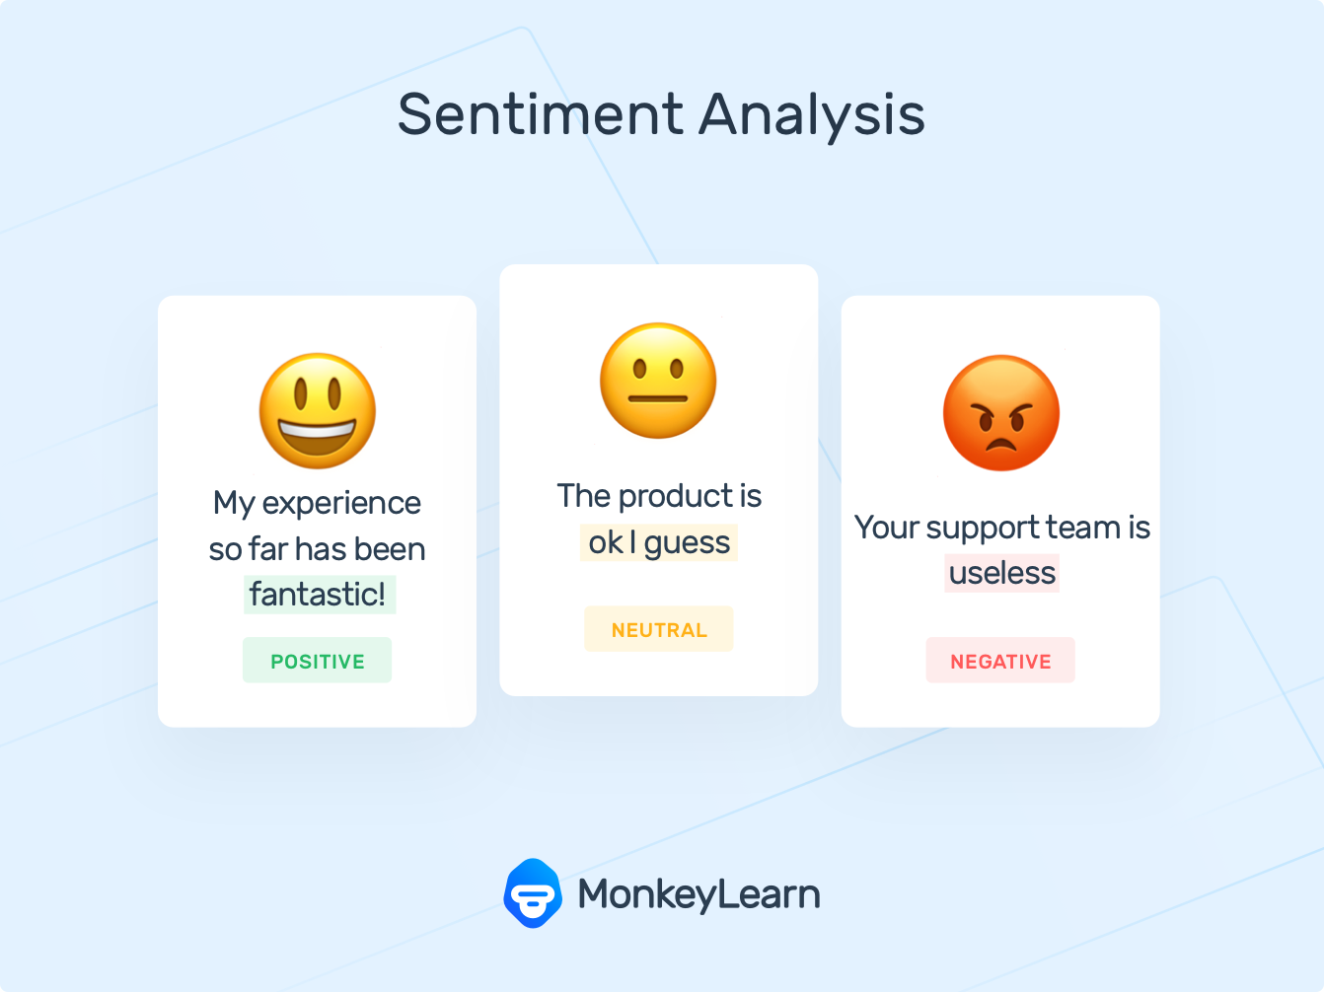
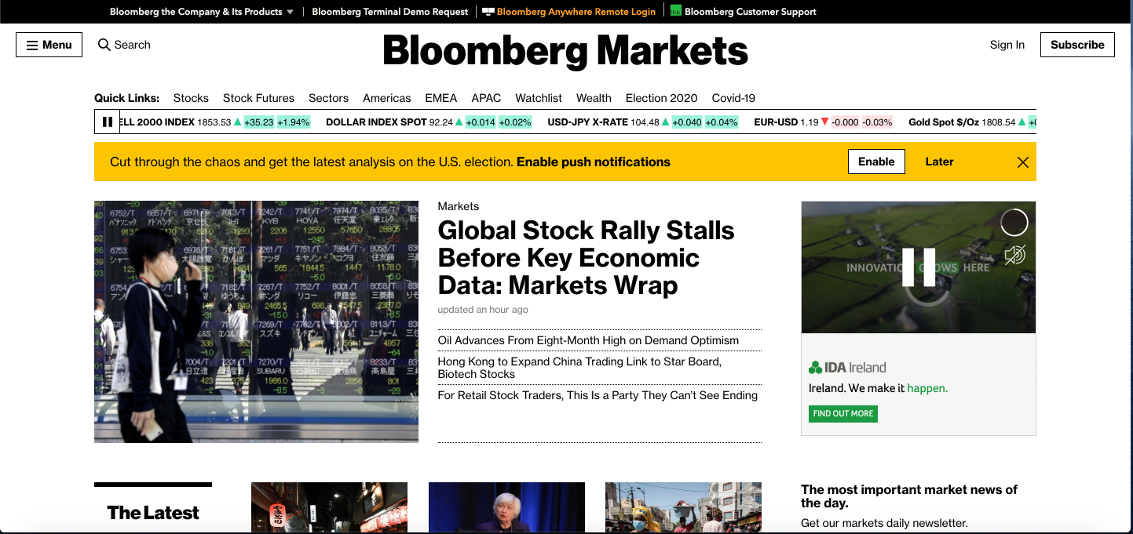
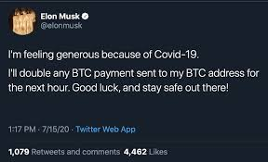

Our initial idea was to predict the (short-term) movement of Bitcoin based on news and Social Media
Use sentiment analysis on tweets and news about bitcoin to predict the change in BTC stock price
NEWS
TWEETS
SENTIMENT ANALYSIS
POSITIVE
+
NEUTRAL
NEGATIVE
Tweets were useless - R Squared 3%
Tweets with many different languages
Sentiment analysis was too heavy to run with all data

Slide 4









The goal is to create a model that will tell us whether the bitcoin closing price of tomorrow will be higher or lower than today’s closing price
What do we predict?
Bitcoin closing price, closing price of the next day
Type of prediction?
2 Class Classification using deep learning model (RNN: Recurrent Neural Network)
How?
Time series analysis using historical data on Bitcoin and its features
S&P 500
CLOSING PRICE
DAY N
OPENING PRICE
DAY N
CLOSING PRICE
DAY N+1
NOT USED
BTC
WHAT WE PREDICT

Slide 5
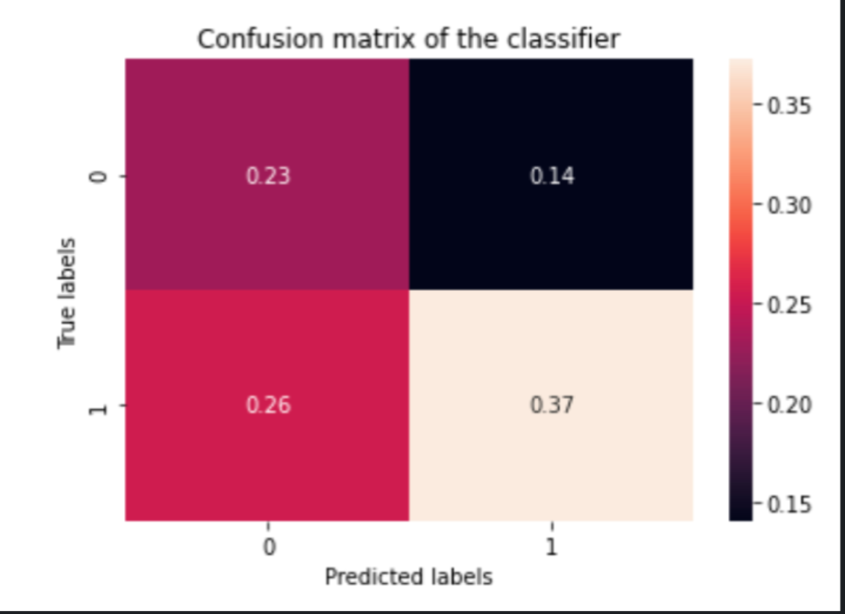
What does this mean in terms of risk preferences?
RISK AVERSE
When the stock price is predicted to rise but it actually falls 14%
RISK LOVING
When stock price is predicted to fall but it actually rises 26%

Slide 6
LET’S TEST IT!
6

Slide 7
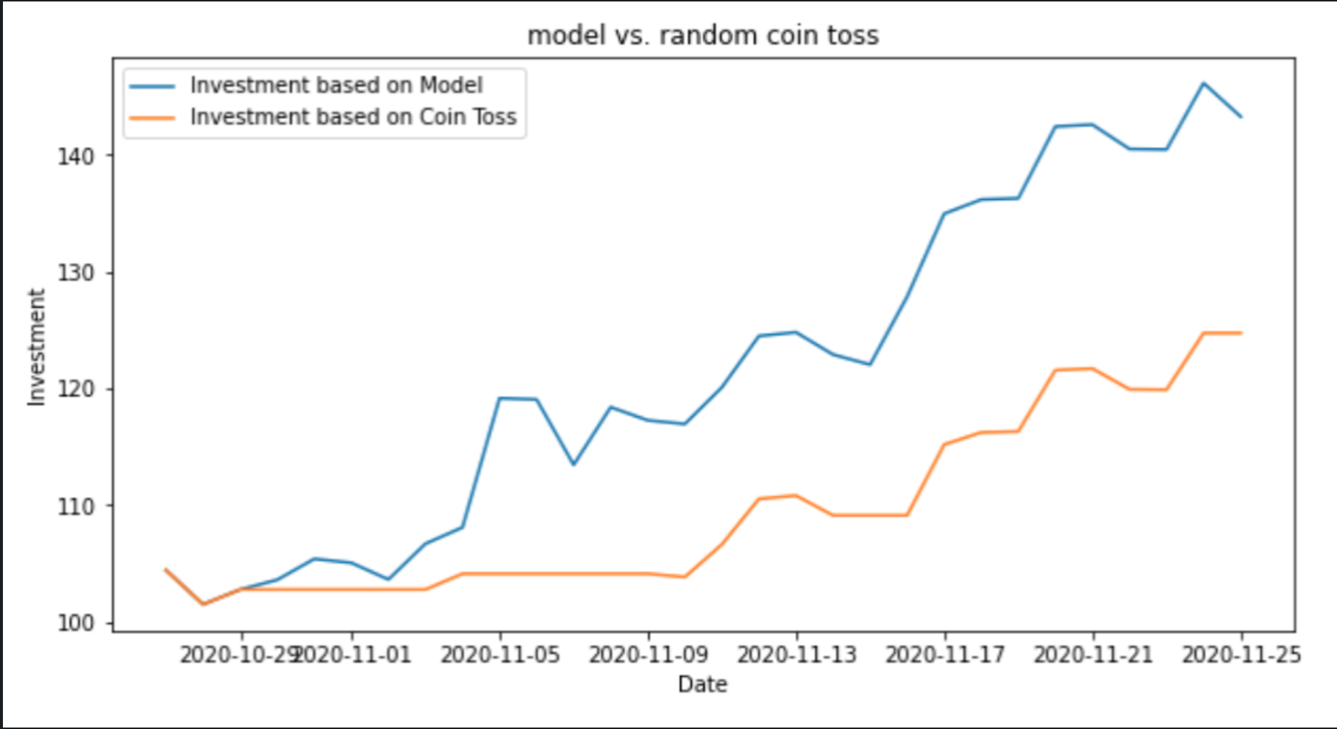
In order to see how good our model is we compare it with tossing a coin (50/50) in order to decide wether to invest or not
What do we predict?
Cumulative amount from investing 100$ and deciding to invest/or not everyday for the last 2 weeks
BEST OPTION!!
MDEL
140 $
COIN TOSS
120$
VS.
ROI
40%
ROI
20%

Slide 8


During project weeks we found ouserlves with some limitations and next steps we would have done if we had more time
LIMITATIONS
Model evolution
Binary classification
Model consistency
GOING FURTHER
Add different features
Use more data to backtest
Try different models

Slide 9
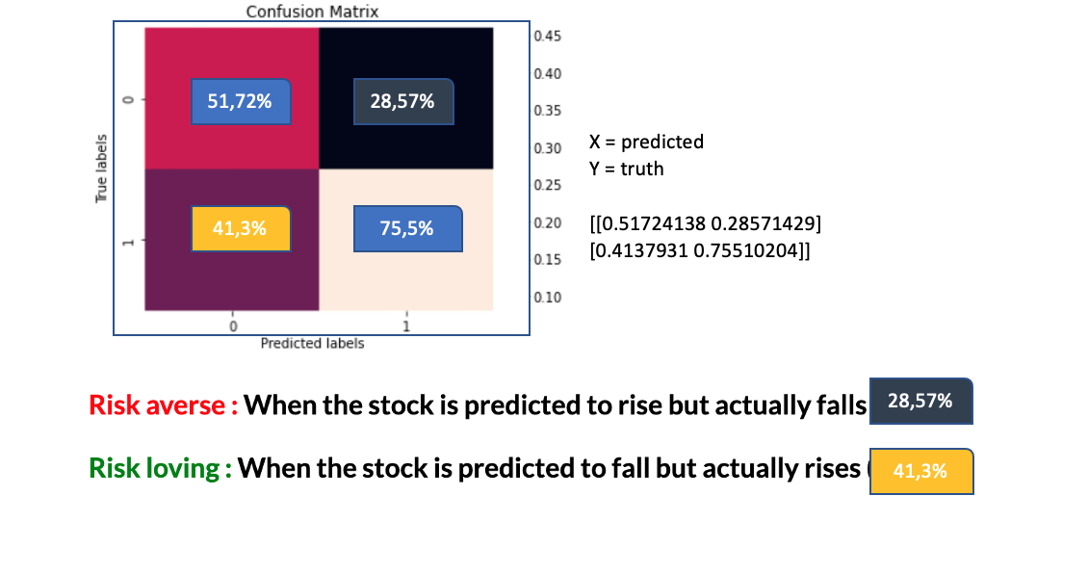
What does this mean in terms of risk preferences?
# accuracy 61%
# recall 73%
# precision 68%
RISK AVERSE
When the stock price is predicted to rise but it actually falls
RISK LOVING
When stock price is predicted to fall but it actually rises

